Slide 1
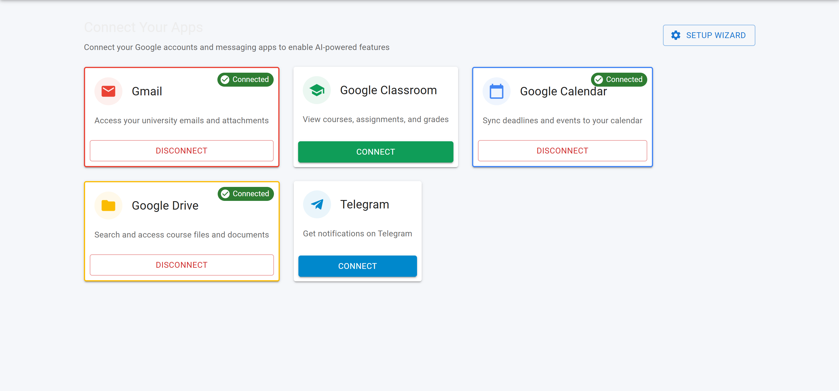

Collegiate Inbox Navigator
Your AI-powered academic companion
Presented by Kon'nichiwa sekai🎓
November 8, 2025, Hackathon Challenge 5

Slide 2


Problem Statement
Understanding the challenges students face today
Missing important deadlines and announcements
Fragmented academic data across multiple platforms
Lack of a centralized academic communication tool
Information overload and disorganization in academics
2

Slide 3
Solution Overview
A Unified AI-Driven Dashboard for Students
Centralized Integration
AI Task Management
Automated Alerts
The Collegiate Inbox Navigator consolidates various platforms like Gmail, Google Classroom, Google Drive, and Calendar, ensuring students can access all academic communications in one streamlined location.
Powered by Gemini AI, the dashboard summarizes emails and extracts actionable tasks, helping students prioritize their responsibilities and stay organized without feeling overwhelmed by information overload.
This system automatically syncs events and sends timely alerts for upcoming deadlines, ensuring that students remain informed of important dates and changes to their schedules.
3

Slide 4
Tech Stack Overview
Key Technologies and System Design
Frontend Framework
Backend Infrastructure
AI Integration
The frontend is built using Next.js 16 and React 19, leveraging MUI v7 for a modern and responsive user interface that enhances user experience across devices.
Composio v3 enables seamless integrations with Gmail, Drive, and Calendar
The AI layer employs Gemini 2.0 Flash with an Agentic RAG pipeline to enable smart data processing and task extraction, enhancing academic workflow and productivity for users.
Our backend system relies on Firebase Authentication for secure user management and Firestore database for efficient data storage, ensuring reliable access to user-generated academic data.
4

Slide 5


Core Features
Deadlines
Document Repository
Alerts
Countdown timers ensure students never miss important deadlines.
Auto-organized academic documents for easy, efficient access.
Real-time alerts notify users of reschedules and cancellations.
Semantic Search
AI Summaries
Centralize place
Planned feature will enhance search capabilities for documents.
AI-generated summaries will simplify lengthy emails for users.
Integrated 4 google service connected by agent tools.
5

Slide 6
Results & Status
Current Achievements and Challenges Ahead
Integrations Functional
AI Analysis Operational
Classroom API Issues
Our Gmail and Calendar integrations are fully operational, enabling students to receive timely notifications and manage their academic schedules effectively, improving overall productivity and organization.
The Firestore database is successfully caching data and conducting AI analysis, ensuring that students have access to summarized and actionable insights tailored to their academic needs.
Currently, the Google Classroom API is non-functional, which has led us to rely on a Gmail-based RAG pipeline. We feel this problem statment cant be solved bec of google internal changes.
6

Slide 7
Future Work
Vision for Project Growth and Impact
Modular Platform
Semantic Search
Contextual Reminders
Integrating a Modular Composable Platform (MCP) will enhance flexibility, allowing users to customize their experience by adding or removing features as needed for effective academic management.
Implementing full semantic search capabilities will enable students to efficiently find and retrieve critical information across emails and documents, streamlining their academic workflow significantly.
Developing smart contextual reminders will proactively assist students by predicting workload and deadlines, ensuring they stay organized and on track to meet their academic goals.
7

